Slide 1
UNIT II: Process Concepts

Slide 2
Unit II
Processes:
  Definition, Process Relationship
  Different states of a Process, Process State transitions
  Process Control Block (PCB)
  Context switching
Thread:
  Definition, Various states, Benefits of threads
  Types of threads
  Concept of multithreads
Process Scheduling: Foundation and Scheduling objectives, Types of Schedulers
Scheduling criteria
Scheduling algorithms: Pre-emptive and Non pre-emptive - FCFS, SJF, RR
Multiprocessor scheduling

Slide 3
Process Concept
An operating system executes a variety of programs:
  Batch system – jobs
  Time-shared systems – user programs or tasks
Textbook uses the terms job and process almost interchangeably
Process – a program in execution; process execution must progress in sequential fashion
Multiple parts
  The program code, also called text section
  Current activity including program counter, processor registers
  Stack containing temporary data
    Function parameters, return addresses, local variables
  Data section containing global variables
  Heap containing memory dynamically allocated during run time using functions like new or malloc.

Slide 4
Process Concept (Cont.)
Program is passive entity stored on disk (executable file), process is active
  Program becomes process when executable file loaded into memory
Execution of program started via GUI mouse clicks, command line entry of its name, etc
One program can be several processes
  Consider multiple users executing the same program

Slide 5

Process in Memory

Slide 6
Process State
As a process executes, it changes state
  new: The process is being created
  ready: The process is waiting to be assigned to a processor. A ready process may be scheduled to run by the operating system
  running: Instructions are being executed. When running, it may be preempted and returned to the ready state
  waiting: The process is waiting for some event to occur such as an I/O operation
  terminated: The process has finished execution

Slide 7

Diagram of Process State

Slide 8

Process Control Block (PCB)
Information associated with each process
(also called task control block)
Process state – running, waiting, etc
Program counter – location of instruction to next execute
CPU registers – contents of all process-centric registers
  Instruction Register (IR) with the current instruction being executed.
  Stack Pointer (SP): the address of the current stack frame, including the function’s local variables and return information.
  General purpose registers used to store addresses and data values as directed by the compiler.

Slide 9
Process Control Block (PCB) – cont..
CPU scheduling information- priorities, scheduling queue pointers
Memory-management information – memory allocated to the process
Accounting information – CPU used, clock time elapsed since start, time limits
I/O status information – I/O devices allocated to process, list of open files

Slide 10
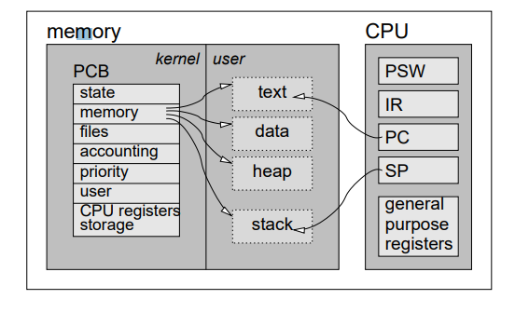
Process Control Block (PCB) – cont..
the stack is used to save register contents, and that the PCB also has space to save register contents. When is each used?

Slide 11
Context Switch
When CPU switches to another process, the system must save the state of the old process and load the saved state for the new process via a context switch
Context of a process represented in the PCB
Context-switch time is overhead; the system does no useful work while switching
  The more complex the OS and the PCB ➔ the longer the context switch
Time dependent on hardware support
  Some hardware provides multiple sets of registers per CPU ➔ multiple contexts loaded at once

Slide 12

CPU Switch From Process to Process

Slide 13
Threads
So far, process has a single thread of execution
Consider having multiple program counters per process
  Multiple locations can execute at once
    Multiple threads of control -> threads
Must then have storage for thread details, multiple program counters in PCB

Slide 14
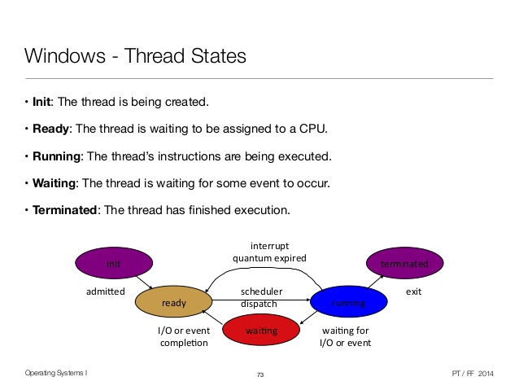

Slide 15
Difference between Process and thread
S.No | Process | Thread
1 | Process is heavy weight | Thread is light weight
2 | Process switching needs interaction with operating system. | Thread switching does not need to interact with operating system.
3 | In multiple processing environments, each process executes the same code but has its own memory and file resources. | All threads can share same set of open files, child processes.
4 | If one process is blocked, then no other process can execute until the first process is unblocked. | While one thread is blocked and waiting, a second thread in the same task can run.
5 | Multiple processes without using threads use more resources. | Multiple threaded processes use fewer resources.
6 | In multiple processes each process operates independently of the others. | One thread can read, write or change another thread's data.

Slide 16
Benefits
Responsiveness – may allow continued execution if part of process is blocked, especially important for user interfaces
Resource Sharing – threads share resources of process, easier than shared memory or message passing
Economy – cheaper than process creation, thread switching lower overhead than context switching
Scalability – process can take advantage of multiprocessor architectures

Slide 17
Multithreading
A process is divided into number of smaller tasks each task is called a Thread.
Number of Threads with in a Process execute at a time is called Multithreading.
If a program, is multithreaded, even when some portion of it is blocked, the whole program is not blocked. The rest of the program continues working If multiple CPU’s are available.
Multithreading gives best performance. If we have only a single thread, number of CPU’s available, No performance benefits achieved.
Process creation is heavy-weight while thread creation is light-weight
Can simplify code, increase efficiency

Slide 18

Single and Multithreaded Processes

Slide 19
Types of Threads
In the operating system, there are two types of threads.
Kernel thread.
User thread.
User threads - management done by user-level threads library
Three primary thread libraries:
  POSIX Pthreads
  Windows threads
  Java threads
Kernel threads - Supported by the Kernel
Examples – virtually all general purpose operating systems, including:
  Windows
  Solaris
  Linux
  Tru64 UNIX
  Mac OS X

Slide 20
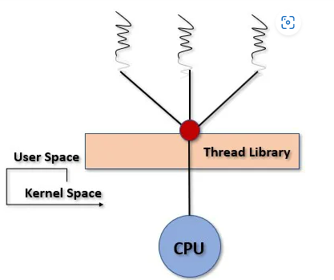
User threads
Thread creation, scheduling, management happen in user space by Thread Library. user threads are faster to create and manage.
User threads can be easily implemented and it is implemented by the user.
The operating system does not recognize the user-level thread
If a user performs a user-level thread blocking operation, the whole process is blocked.
The kernel level thread does not know nothing about the user level thread.
Three primary thread libraries:
  POSIX Pthreadsl
  Win32 threads
  Java threads

Slide 21
User threads
Advantages
Thread switching does not require Kernel mode privileges.
User level thread can run on any operating system.
Scheduling can be application specific in the user level thread.
User level threads are fast to create and manage.
Disadvantages
In a typical operating system, most system calls are blocking.
Multithreaded application cannot take advantage of multiprocessing.

Slide 22
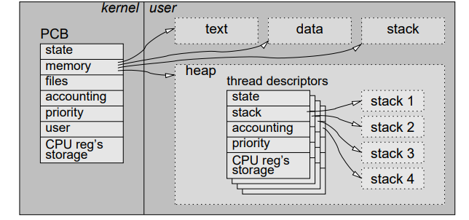
Implementation of user thread

Slide 23
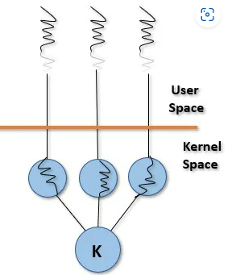
Kernel threads
kernel creates, schedules, manages these threads .these threads are slower, manage.
thread management is done by the Kernel.
Kernel threads are supported directly by the operating system.
All of the threads within an application are supported within a single process.
The Kernel maintains context information for the process as a whole and for individuals threads within the process. The Kernel performs thread creation, scheduling and management in Kernel space.
Kernel threads are generally slower to create and manage than the user threads.
Examples Windows XP/2000
Solaris
Linux
Tru64 UNIX

Slide 24
Kernel threads
Advantages
Kernel can simultaneously schedule multiple threads from the same process on multiple processes.
If one thread in a process is blocked, the Kernel can schedule another thread of the same process.
Kernel routines themselves can be multithreaded.
Disadvantages
Kernel threads are generally slower to create and manage than the user threads.
Transfer of control from one thread to another within the same process requires a mode switch to the Kernel.

Slide 25
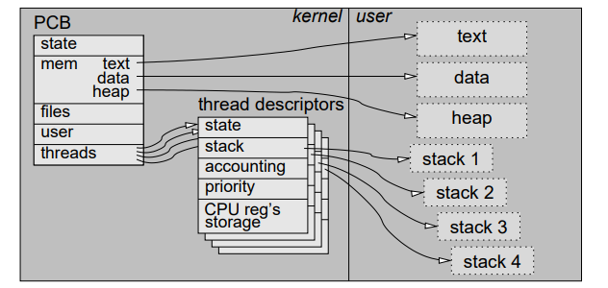
Implementation of kernel thread

Slide 26
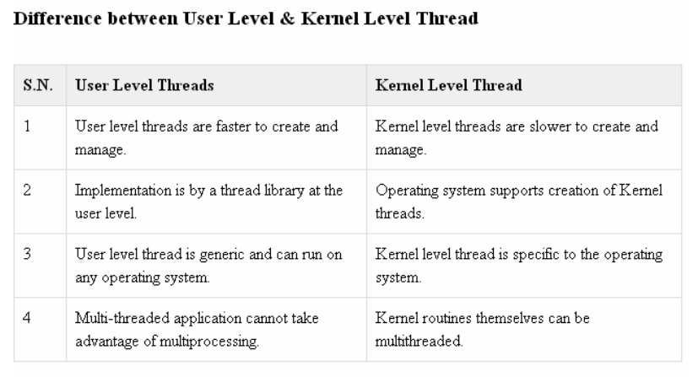

Slide 27
Multithreading Models
Some operating system provides a combined user level thread and Kernel level thread facility.
Solaris is a good example of this combined approach.
In a combined system, multiple threads within the same application can run in parallel on multiple processors and a blocking system call need not block the entire process.
Multithreading models are three types
Many-to-One
One-to-One
Many-to-Many

Slide 28

Many-to-One
Many user-level threads mapped to single kernel thread
One thread blocking causes all to block
Multiple threads may not run in parallel on muticore system because only one may be in kernel at a time
Few systems currently use this model
Examples:
  Solaris Green Threads
  GNU Portable Threads

Slide 29

One-to-One
Each user-level thread maps to kernel thread
Creating a user-level thread creates a kernel thread
More concurrency than many-to-one
Number of threads per process sometimes restricted due to overhead
Examples
  Windows
  Linux
  Solaris 9 and later

Slide 30

Many-to-Many Model
Allows many user level threads to be mapped to many kernel threads
Allows the operating system to create a sufficient number of kernel threads
Solaris prior to version 9
Windows with the ThreadFiber package

Slide 31
Process Scheduling
Maximize CPU use, quickly switch processes onto CPU for time sharing
Process scheduler selects among available processes for next execution on CPU
Maintains scheduling queues of processes
  Job queue – set of all processes in the system
  Ready queue – set of all processes residing in main memory, ready and waiting to execute
  Device queues – set of processes waiting for an I/O device
  Processes migrate among the various queues

Slide 32

Representation of Process Scheduling
Queueing diagram represents queues, resources, flows

Slide 33
Schedulers
Short-term scheduler (or CPU scheduler) – selects which process should be executed next and allocates CPU
  Sometimes the only scheduler in a system
  Short-term scheduler is invoked frequently (milliseconds) ⇒ (must be fast)
Long-term scheduler (or job scheduler) – selects which processes should be brought into the ready queue
  Long-term scheduler is invoked infrequently (seconds, minutes) ⇒ (may be slow)
  The long-term scheduler controls the degree of multiprogramming
Processes can be described as either:
  I/O-bound process – spends more time doing I/O than computations, many short CPU bursts
  CPU-bound process – spends more time doing computations; few very long CPU bursts
Long-term scheduler strives for good process mix

Slide 34

Addition of Medium Term Scheduling
Medium-term scheduler can be added if degree of multiple programming needs to decrease
  Remove process from memory, store on disk, bring back in from disk to continue execution: swapping

Slide 35

Basic Concepts
Maximum CPU utilization obtained with multiprogramming
CPU–I/O Burst Cycle – Process execution consists of a cycle of CPU execution and I/O wait
CPU burst followed by I/O burst
CPU burst distribution is of main concern

Slide 36
Scheduling Criteria
CPU utilization – keep the CPU as busy as possible
Throughput – # of processes that complete their execution per time unit
Turnaround time – amount of time to execute a particular process
Waiting time – amount of time a process has been waiting in the ready queue
Response time – amount of time it takes from when a request was submitted until the first response is produced, not output (for time-sharing environment) -the difference between the arrival time (ready state) and the time at which the process first gets the CPU

Slide 37
Scheduling Algorithm Optimization Criteria
Max CPU utilization
Max throughput
Min turnaround time
Min waiting time
Min response time

Slide 38
CPU SCHEDULING
Non-preemptive scheduling: A scheduling discipline is nonpreemptive , if once a process has been used the CPU, the CPU cannot be taken away from that process.
  The running process keeps the CPU until it voluntarily gives up the CPU
    process exits
    switches to blocked state
    Transition 3 is only voluntary
Preemptive scheduling:
  The running process can be interrupted and must release the CPU (can be forced to give up CPU)

Slide 39

First- Come, First-Served (FCFS) Scheduling
Process Burst Time
P₁ 24
P₂ 3
P₃ 3
Suppose that the processes arrive in the order: P₁ , P₂ , P₃
The Gantt Chart for the schedule is:

Slide 40
FCFS ( Cont..)
Process | Arrival time(AT ) | Burst time (BT) | Completion time (CT) | Turn Around Time (CT-AT) | Waiting time (TAT – BT)
P1 | 0 | 24 | 24 | 24 | 0
P2 | 0 | 3 | 27 | 27 | 24
P3 | 0 | 3 | 30 | 30 | 27
Since all process arrive at same time ( 0 ms)
If arrival times is 0, then turn around and completion times are same.
Waiting time for P₁ = 0; P₂ = 24; P₃ = 27
Average waiting time: (0 + 24 + 27)/3 = 17
Average turnaround time: (24 + 27 + 30)/3 = 27

Slide 41
FCFS (Cont…)
Process | Arrival time(AT ) | Burst time (BT) | Completion time (CT) | Turn Around Time (CT-AT) | Waiting time (TAT – BT)
P1 | 0 | 24 | 24 | 24 | 0
P2 | 1 | 3 | 27 | 26 | 23
P3 | 2 | 3 | 30 | 28 | 25
 |  |  |  | 78 | 48
Since all process arrive at different time
Waiting time for P₁ = 0; P₂ = 23; P₃ = 25
Average waiting time: (0 + 23 + 25)/3 = 48/3 = 24
Average turnaround time: ( 24 + 26 + 28)/3 = 78/3 = 26

Slide 42

FCFS Scheduling (Cont.)
Suppose that the processes arrive in the order:
P₂ , P₃ , P₁
The Gantt chart for the schedule is:
Waiting time for P₁ = 6; P₂ = 0; P₃ = 3
Average waiting time: (6 + 0 + 3)/3 = 3
Much better than previous case
Convoy effect - short process behind long process
  Consider one CPU-bound and many I/O-bound processes

Slide 43
FCFS (Cont..)
The advantages of FCFS CPU Process Scheduling are:
In order to allocate processes, it uses the First In First Out queue.
straight forward and easy to implement.
In the FCFS situation pre emptive scheduling, there is no chance of process starving.
Disadvantages of FCFS CPU Process Scheduling
It has Long Waiting Time
Short processes that are at the back of the queue have to wait for the long process at the front to finish leads to a a chance of occurrence of Convoy Effect
Not an ideal technique for time-sharing systems.
Because of its simplicity, FCFS is not very efficient.

Slide 44
Shortest-Job-First (SJF) Scheduling
Associate with each process the length of its next CPU burst
  Use these lengths to schedule the process with the shortest time
SJF is optimal – gives minimum average waiting time for a given set of processes
  The difficulty is knowing the length of the next CPU request
  Could ask the user

Slide 45

Example of SJF
ProcessArriva l Time Burst Time
P₁ 0.0 6
P₂ 2.0 8
P₃ 4.0 7
P₄ 5.0 3
SJF scheduling Gantt chart

Slide 46
SJF ( Cont..)
Process | Arrival time(AT ) | Burst time (BT) | Completion time (CT) | Turn Around Time (CT-AT) | Waiting time (TAT – BT)
P4 | 0 | 3 | 3 | 3 | 0
P1 | 0 | 6 | 9 | 9 | 9
P3 | 0 | 7 | 16 | 16 | 16
P2 | 0 | 8 | 24 | 24 | 24
Process | Arrival time(AT ) | Burst time (BT) | Completion time (CT) | Turn Around Time (CT-AT) | Waiting time (TAT – BT)
P4 | 0 | 3 | 3 | 3 | 0
P1 | 0 | 6 | 9 | 9 | 9
P3 | 0 | 7 | 16 | 16 | 16
P2 | 0 | 8 | 24 | 24 | 24
Average waiting time = (0 + 9 + 16 + 24) / 4 = 12.25
Average Turnaround time = ( 3 + 9+ 16 + 24) / 4 = 13

Slide 47
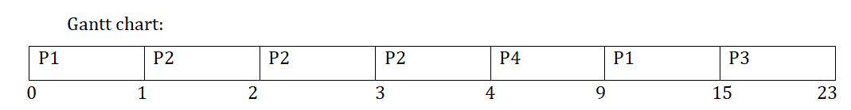
Pre-emptive SJF (SRTF)
Process | Arrival time(AT ) | Burst time (BT)
P1 | 0 | 7
P2 | 1 | 3
P3 | 2 | 8
P4 | 3 | 5

Slide 48

Pre-emptive SJF (SRTF)
Process | Arrival time(AT ) | Burst time (BT) | Completion time (CT) | Turn Around Time (CT-AT) | Waiting time (TAT – BT)
P1 | 0 | 7 | 15 | 15 | 8
P2 | 1 | 3 | 4 | 3 | 0
P3 | 2 | 8 | 23 | 21 | 13
P4 | 3 | 5 | 9 | 6 | 1
Average waiting time = (8 + 0 + 13 + 1) / 4 = 5.5 ms
Average Turnaround time = ( 15 + 3+ 21 + 6) / 4 = 11.25 ms

Slide 49
Round Robin (RR)
Each process gets a small unit of CPU time (time quantum q), usually 10-100 milliseconds. After this time has elapsed, the process is preempted and added to the end of the ready queue.
If there are n processes in the ready queue and the time quantum is q, then each process gets 1/n of the CPU time in chunks of at most q time units at once. No process waits more than (n-1)q time units.
Timer interrupts every quantum to schedule next process
Performance
  q large ⇒ FIFO
  q small ⇒ q must be large with respect to context switch, otherwise overhead is too high

Slide 50

Example of RR with Time Quantum = 4
Process Burst Time
P₁ 24
P₂ 3
P₃ 3
The Gantt chart is:
Typically, higher average turnaround than SJF, but better response
q should be large compared to context switch time
q usually 10ms to 100ms, context switch < 10 usec

Slide 51

Time Quantum and Context Switch Time

Slide 52
Round Robin (Cont..)
Process | Arrival time(AT ) | Burst time (BT) | Completion time (CT) | Turn Around Time (CT-AT) | Waiting time (TAT – BT)
P1 | 0 | 30 | 44 | 44 | 14
P2 | 0 | 6 | 21 | 21 | 15
P3 | 0 | 8 | 24 | 24 | 16
AVERAGE WAITING TIME :
Waiting time for P1 => 0+(15-5)+(24-20) => 0+10+4 = 14
Waiting time for P2 => 5+(20-10) => 5+10 = 15
Waiting time for P3 => 10+(21-15) => 10+6 = 16
Average waiting time => (14+15+16)/3 = 15 ms
Average TAT=> ( 44 + 21 + 24) / 3 = 29.6 ms

Slide 53
Example of RR with Time Quantum = 5
Process Burst Time
P₁ 30
P₂ 6
P₃ 8
The Gantt chart is:

Slide 54
Priority Scheduling
A priority number (integer) is associated with each process
The CPU is allocated to the process with the highest priority (smallest integer ≡ highest priority)
  Preemptive
  Nonpreemptive
SJF is priority scheduling where priority is the inverse of predicted next CPU burst time
Problem ≡ Starvation – low priority processes may never execute
Solution ≡ Aging – as time progresses increase the priority of the process

Slide 55

Example of Priority Scheduling
ProcessA arri Burst TimeT Priority
P₁ 10 3
P₂ 1 1
P₃ 2 4
P₄ 1 5
P₅ 5 2
Priority scheduling Gantt Chart
Average waiting time = 8.2 msec

Slide 56
Multilevel Queue
Ready queue is partitioned into separate queues, eg:
  foreground (interactive)
  background (batch)
Process permanently in a given queue
Each queue has its own scheduling algorithm:
  foreground – RR
  background – FCFS
Scheduling must be done between the queues:
  Fixed priority scheduling; (i.e., serve all from foreground then from background). Possibility of starvation.
  Time slice – each queue gets a certain amount of CPU time which it can schedule amongst its processes; i.e., 80% to foreground in RR
  20% to background in FCFS

Slide 57

Multilevel Queue Scheduling

Slide 58
Multilevel Feedback Queue
A process can move between the various queues; aging can be implemented this way
Multilevel-feedback-queue scheduler defined by the following parameters:
  number of queues
  scheduling algorithms for each queue
  method used to determine when to upgrade a process
  method used to determine when to demote a process
  method used to determine which queue a process will enter when that process needs service

Slide 59

Example of Multilevel Feedback Queue
Three queues:
  Q₀ – RR with time quantum 8 milliseconds
  Q₁ – RR time quantum 16 milliseconds
  Q₂ – FCFS
Scheduling
  A new job enters queue Q₀ which is served FCFS
    When it gains CPU, job receives 8 milliseconds
    If it does not finish in 8 milliseconds, job is moved to queue Q₁
  At Q₁ job is again served FCFS and receives 16 additional milliseconds
    If it still does not complete, it is preempted and moved to queue Q₂

Slide 60
Thread Scheduling
Many-to-one and many-to-many models, thread library schedules user-level threads to run on LWP
  Known as process-contention scope (PCS) since scheduling competition is within the process
  Typically done via priority set by programmer
Kernel thread scheduled onto available CPU is system-contention scope (SCS) – competition among all threads in system

Slide 61

Linux Scheduling
Real-time scheduling according to POSIX.1b
  Real-time tasks have static priorities
Real-time plus normal map into global priority scheme
Nice value of -20 maps to global priority 100
Nice value of +19 maps to priority 139

Slide 62
Windows Scheduling
Windows uses priority-based preemptive scheduling
Highest-priority thread runs next
Dispatcher is scheduler
Thread runs until (1) blocks, (2) uses time slice, (3) preempted by higher-priority thread
Real-time threads can preempt non-real-time
32-level priority scheme
Variable class is 1-15, real-time class is 16-31
Priority 0 is memory-management thread
Queue for each priority
If no run-able thread, runs idle thread

Slide 63
Windows Priority Classes
Win32 API identifies several priority classes to which a process can belong
  REALTIME_PRIORITY_CLASS, HIGH_PRIORITY_CLASS, ABOVE_NORMAL_PRIORITY_CLASS,NORMAL_PRIORITY_CLASS, BELOW_NORMAL_PRIORITY_CLASS, IDLE_PRIORITY_CLASS
  All are variable except REALTIME
A thread within a given priority class has a relative priority
  TIME_CRITICAL, HIGHEST, ABOVE_NORMAL, NORMAL, BELOW_NORMAL, LOWEST, IDLE
Priority class and relative priority combine to give numeric priority
Base priority is NORMAL within the class
If quantum expires, priority lowered, but never below base

Slide 64
Windows Priority Classes (Cont.)
If wait occurs, priority boosted depending on what was waited for
Foreground window given 3x priority boost
Windows 7 added user-mode scheduling (UMS)
  Applications create and manage threads independent of kernel
  For large number of threads, much more efficient
  UMS schedulers come from programming language libraries like C++ Concurrent Runtime (ConcRT) framework

Slide 65

Algorithm Evaluation
How to select CPU-scheduling algorithm for an OS?
Determine criteria, then evaluate algorithms
Deterministic modeling
  Type of analytic evaluation
  Takes a particular predetermined workload and defines the performance of each algorithm for that workload
Consider 5 processes arriving at time 0:

Slide 66



Deterministic Evaluation
For each algorithm, calculate minimum average waiting time
Simple and fast, but requires exact numbers for input, applies only to those inputs
  FCS is 28ms:
  Non-preemptive SFJ is 13ms:
  RR is 23ms:

Slide 67
Queueing Models
Describes the arrival of processes, and CPU and I/O bursts probabilistically
  Commonly exponential, and described by mean
  Computes average throughput, utilization, waiting time, etc
Computer system described as network of servers, each with queue of waiting processes
  Knowing arrival rates and service rates
  Computes utilization, average queue length, average wait time, etc

Slide 68
Little’s Formula
n = average queue length
W = average waiting time in queue
λ = average arrival rate into queue
Little’s law – in steady state, processes leaving queue must equal processes arriving, thus:
n = λ x W
  Valid for any scheduling algorithm and arrival distribution
For example, if on average 7 processes arrive per second, and normally 14 processes in queue, then average wait time per process = 2 seconds

